Slide 1
Hypothesis Testing

Slide 2
Hypothesis Testing
Hypothesis Testing is a technique for interpreting and drawing inferences about a population based on sample data.
It aids in determining which sample data best support mutually exclusive population claims.

Slide 3
Types of Hypothesis Testing
Null Hypothesis (H0) :
The Null Hypothesis is the assumption that the event will not occur. A null hypothesis has no bearing on the study's outcome unless it is rejected.
H0 is the symbol for it, and it is pronounced H-naught.
Alternate Hypothesis(H1 or Ha):
The Alternate Hypothesis is the logical opposite of the null hypothesis. The acceptance of the alternative hypothesis follows the rejection of the null hypothesis. H1 is the symbol for it.

Slide 4
What Are Categorical Variables?
Categorical variables can be divided into two categories:
Nominal Variable: A nominal variable's categories have no natural ordering. Example: Gender, Blood groups
Ordinal Variable: A variable that allows the categories to be sorted is ordinal variables. Customer satisfaction (Excellent, Very Good, Good, Average, Bad, and so on) is an example.

Slide 5
Chi-square test
A chi-square test is a statistical test that is used to compare observed and expected results.
The goal of this test is to identify whether a disparity between actual and predicted data is due to chance or to a link between the variables under consideration.
As a result, the chi-square test is an ideal choice for aiding in our understanding and interpretation of the connection between our
A chi-square test or comparable nonparametric test is required to test a hypothesis regarding the distribution of a categorical variable.two categorical variables.

Slide 6
There are two main types of Chi-Square tests namely -
Independence
Goodness-of-Fit
The Chi-Square Test gives a "p" value to help you decide!
Now, p < 0.05 is the usual test for dependence.
p is greater than 0.05, so we believe the variables are independent (i.e. not linked together).
p is less than 0.05, so this result is thought of as being "significant" meaning we think the variables are not independent.

Slide 7
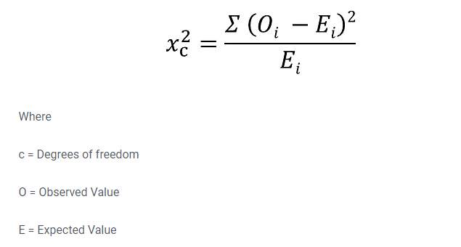
Chi-square test formula

Slide 8
Chi-square test
There are two main types of Chi-Square tests namely -
1.Independence
The Chi-Square Test of Independence is a derivable ( also known as inferential ) statistical test which examines whether the two sets of variables are likely to be related with each other or not. This test is used when we have counts of values for two nominal or categorical variables and is considered as non-parametric test.
Example:
In a movie theatre, suppose we made a list of movie genres. Let us consider this as the first variable. The second variable is whether or not the people who came to watch those genres of movies have bought snacks at the theatre. Here the null hypothesis is that th genre of the film and whether people bought snacks or not are unrelatable. If this is true, the movie genres don’t impact snack sales.

Slide 9
Chi-square test
There are two main types of Chi-Square tests namely -
2.Goodness-of-Fit
In statistical hypothesis testing, the Chi-Square Goodness-of-Fit test determines whether a variable is likely to come from a given distribution or not. We must have a set of data values and the idea of the distribution of this data.
Suppose we have bags of balls with five different colours in each bag. The given condition is that the bag should contain an equal number of balls of each colour. The idea we would like to test here is that the proportions of the five colours of balls in each bag must be exact.

Slide 10
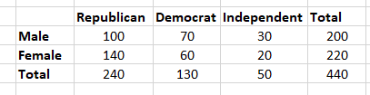
Question
Let's say you want to know if gender has anything to do with political party preference. You poll 440 voters in a simple random sample to find out which political party they prefer. The results of the survey are shown in the table below:

Slide 11


Step 1 Hypothesis Testing
H0: There is no link between gender and political party preference.
H1: There is a link between gender and political party preference.
Step 2 Calculate the Expected Values
For example, the expected value for Male Republicans is:

Slide 12
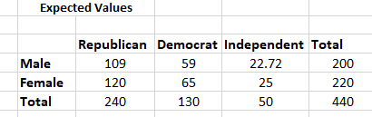
calculate the expected value for each of the cells

Slide 13
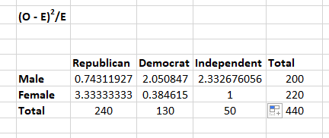
Step 3: Calculate (O-E)2 / E for Each Cell in the Table

Slide 14
Step 4: Calculate the Test Statistic X2
X2 is the sum of all the values in the last table
= 0.743 + 2.05 + 2.33 + 3.33 + 0.384 + 1 = 9.837
Before you can conclude, you must first determine the critical statistic, which requires determining our degrees of freedom. The degrees of freedom in this case are equal to the table's number of columns minus one multiplied by the table's number of rows minus one, or (r-1) (c-1). We have (3-1)(2-1) = 2.
Finally, you compare our obtained statistic to the critical statistic found in the chi-square table. As you can see, for an alpha level of 0.05 and two degrees of freedom, the critical statistic is 5.991, which is less than our obtained statistic of 9.83. You can reject our null hypothesis because the critical statistic is higher than your obtained statistic.
This means you have sufficient evidence to say that there is an association between gender and political party preference.

Slide 15
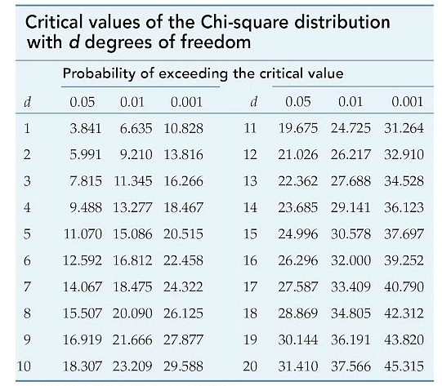

Slide 16
Question
Which pet do you prefer?
 | Cat | Dog
Men | 207 | 282
Women | 231 | 242

Slide 17
Solution
 | Cat | Dog
Men | 207 | 282 | 489
Women | 231 | 242 | 473
 | 438 | 524 | 962
Men | 489×438/962 | 489×524/962 | 489
Women | 473×438/962 | 473×524/962 | 473
 | 438 | 524 | 962
 | Cat | Dog
Men | 222.64 | 266.36 | 489
Women | 215.36 | 257.64 | 473
 | 438 | 524 | 962

Slide 18
Solution
Cat | Dog
Men | (207−222.64)^{2/}222.64 | (282−266.36)^{2/}266.36 | 489
Women | (231−215.36)^{2/}215.36 | (242−257.64)^{2/}257.64 | 473
 | 438 | 524 | 962
 | Cat | Dog
Men | 1.099 | 0.918 | 489
Women | 1.136 | 0.949 | 473
 | 438 | 524 | 962
Now add up those calculated values:
1.099 + 0.918 + 1.136 + 0.949 = 4.102
Chi-Square is 4.102

Slide 19
Solution
From Chi-Square to p
Degrees of Freedom
First we need a "Degree of Freedom"
Degree of Freedom = (rows − 1) × (columns − 1)
For our example we have 2 rows and 2 columns:
DF = (2 − 1)(2 − 1) = 1×1 = 1
p-value
The result is:
p = 0.04283

